Slide 1
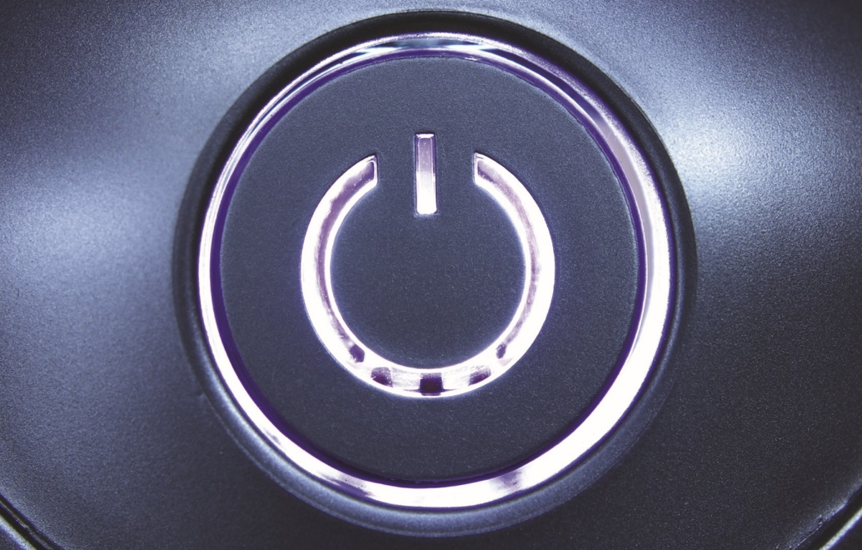
IT Essentials (CompTIA A+) Ch. 8
Power Supplies
Chapter 8

Slide 2
Overview
In this chapter, you will learn how to:
Explain the basics of electricity
Describe the details about powering the PC
Install and maintain power supplies
Understand power supply troubleshooting and fire safety
Notes:
Instructor Tip
When gaining attention and establishing common ground, ask questions of the class such as, “Who here knows the difference between an AT power supply and an ATX power supply?”
For a positive statement, tell the class, “In this lesson, we are going to learn about power supplies and how to test them, and how to protect the computer from electrical sags and spikes.”

Slide 3
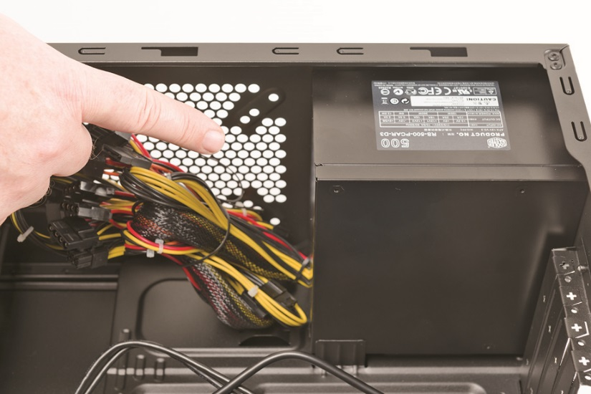
Introduction
Power supply unit (PSU)
Takes AC power and transforms into electricity to power the PC.
Falls in the category of a field replaceable unit (FRU)
Figure 8.1 Typical power supply mounted inside the PC system unit
Notes:
Figure 8.1 shows a typical power supply inside a case. All of the wires dangling out of it connect to the motherboard and peripherals.

Slide 4
Understanding Electricity
Voltage is the pressure of electrons in a wire.
Measured in volts (V)
Current or amperage is the amount of electrons moving past a point in a wire.
Measured in amperes (A)
Wattage is the amount of amps and volts needed so a device will function
Measured in watts (W)
W = V × A

Slide 5
Understanding Electricity
Resistance is opposition to the flow of electrons.
All wires have slight resistance.
Resistance is measured in ohms (Ω).
Wires have amperage ratings.
Defines how much amperage they can handle
Example: 20 amp, 30 amp
If amperage is exceeded:
Wires will heat up and break.

Slide 6
Understanding Electricity
Circuit breakers are heat sensitive or electromagnetically-operated switches rated for a specific amperage.
Sense when amperage exceeds threshold.
Break the circuit to stop the flow of electricity before wiring overheats.
In the past, fuses were used in homes instead of circuit breakers.
Fuse must be replaced every time it blows.
Fuses are still used in PC power supplies.

Slide 7
Two Types of Current
Alternating current (AC) – electrical current flows in both directions
Electricity provided at wall socket
Frequency of alternations measured in cycles per second, or hertz (Hz)
Direct current (DC) – electrical current flows in one direction
Electricity provided by batteries

Slide 8
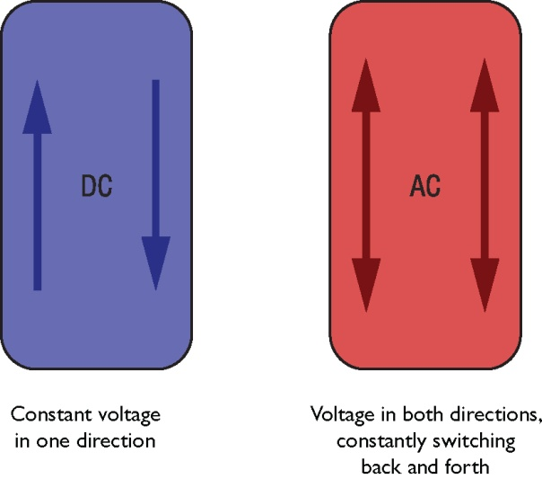
Two Types of Current
Figure 8.2 Diagrams showing DC and AC flow of electrons
Notes:
Electricity comes in two flavors: direct current (DC), in which the electrons flow in one direction around a continuous circuit, and alternating current (AC), in which the flow of electrons alternates direction back and forth in a circuit (see Figure 8.2). Most electronic devices use DC power, but all power companies supply AC power because AC travels long distances much more efficiently than DC.

Slide 9
Powering the PC
PCs use DC voltage.
Power companies supply AC voltage.
The PC’s power supply converts AC to the proper DC voltage and amperage for the motherboard and peripherals.
Notes:
Some questions on the CompTIA A+ exams could refer to a power supply as a PSU, for power supply unit. A power supply also falls into the category of field replaceable unit (FRU), which refers to the typical parts a tech should carry, such as RAM and a floppy disk drive.

Slide 10
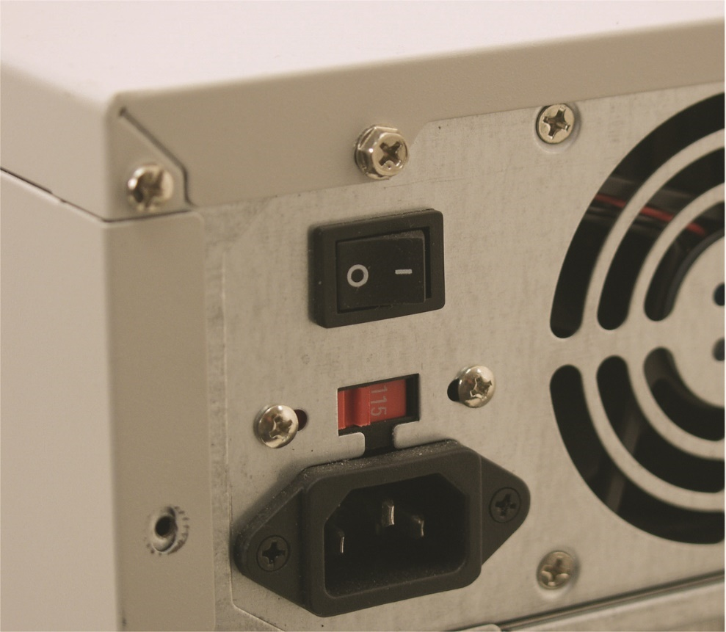
Powering the PC
Figure 8.3 Back of fixed-input power supply, showing typical switches and power connection
Notes:
Safety Alert
Do not flip the switch if you are in an area serviced by 230 volts. In a 115-volt power grid, flipping the switch to 230 will simply make the PSU appear dead, without any real harm. If you are in a 230-volt area, flipping the switch to 115 will likely burn up the power supply, and it could cause a fire!

Slide 11
Supplying AC
Standard IEC-320 connector:
Connects power supply to the power cord
Standard AC in the United States:
110–120 V, often written as ~115 VAC (volts of alternating current)
Most of rest of the world uses 220–240 VAC.
Dual-voltage options are available.
Fixed input power supplies have voltage selection switches.
Auto-switching supplies switch automatically.

Slide 12
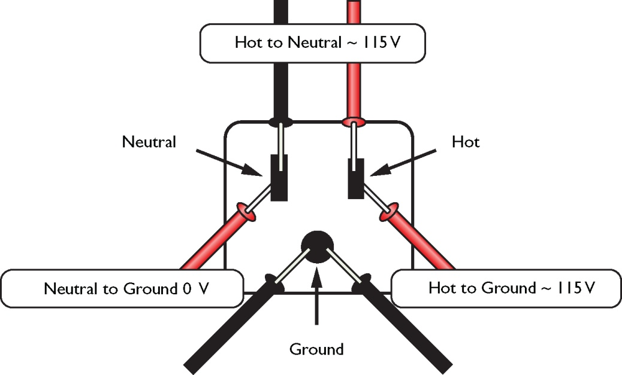
Supplying AC
Hot and neutral provide path for AC.
Hot has 115 V.
Neutral carries no voltage but returns electricity to local source.
Ground is used for safety.
Returns excess electricity to ground
Figure 8.4 Outlet voltages
Notes:
Discussion Point
Electrical Ground
Remember the days when electrical plugs with a ground plug were “optional”? It was around the same time polarized plugs with one blade wider than the other were introduced in the market. It was common to ground down that wider blade or simply snip off the ground plug because the wall outlets or the extension cords were not yet compatible. However, this is unacceptable for computers! Electronics are susceptible to electrical damage. You must have a properly grounded source, including any extension cords.
The plug is called an IEC-320.

Slide 13
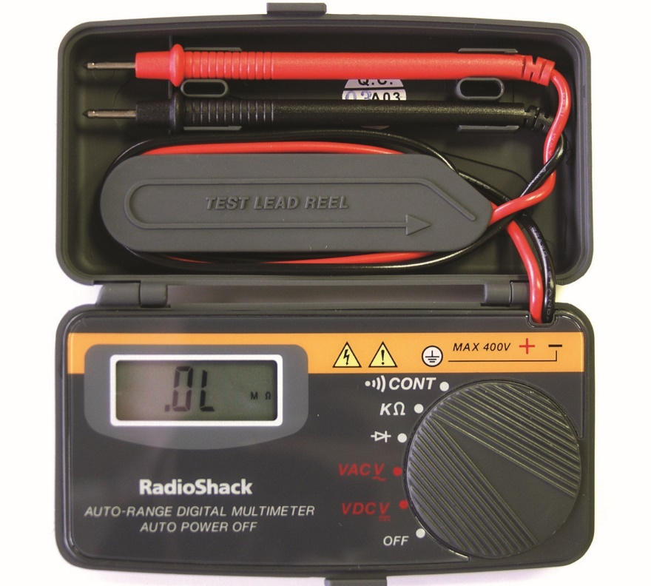
Supplying AC
Multimeter measures:
Continuity
Resistance
AC voltage
DC voltage
Exercise caution with a multimeter.
Learn to use a it correctly.
Set it properly before measuring.
Figure 8.5 Digital multimeter
Notes:
Discussion Point
Testing Equipment
A decent multimeter (or Volt-Ohm meter) can be purchased inexpensively at most electronics or hardware stores; it can test for AC and DC voltage, amperage, continuity, and resistance. Also available is a less-expensive small module tester to test your AC outlet. This simply plugs into the AC outlet and checks for proper voltage, proper wiring, and proper grounding. A series of LED lights on the module shows the results.

Slide 14
Testing AC Voltage
Verify wiring of outlet.
Put one lead in hot, and the other in neutral.
Reading should be 110-120 V AC.
Put one lead in hot, and the other in ground.
Reading should be 110-120 V AC.
Put one lead in neutral, and the other in ground.
Reading should be 0 V AC.

Slide 15
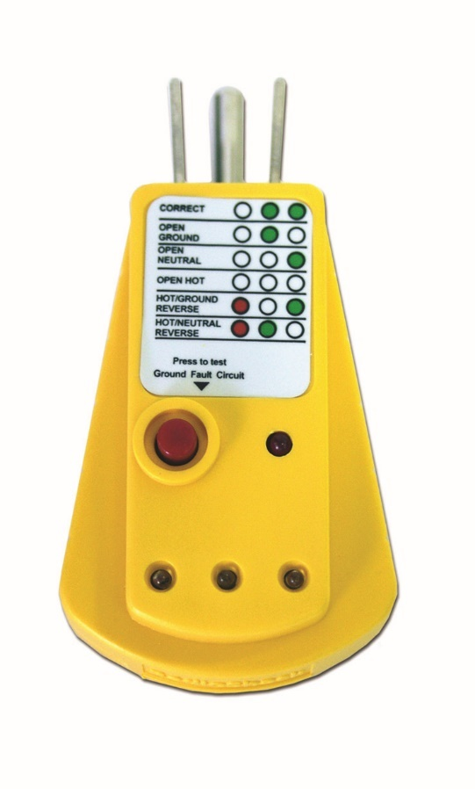
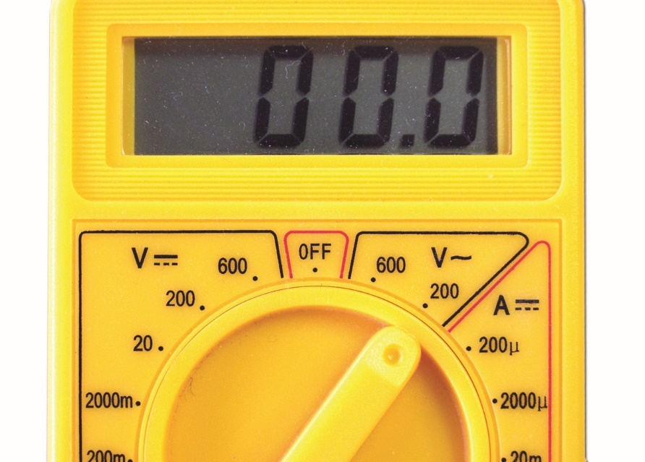
Testing AC Voltage
Figure 8.6 Multimeter featuring DC and AC symbols
Figure 8.7 Circuit tester
Notes:
Simple AC voltage tester/tool (Figure 8.7).

Slide 16
Try This! Testing AC
Set the multimeter to test AC.
Put the leads into a electrical outlet.
What's the voltage between hot and neutral?
What's the voltage between hot and ground?
What's the voltage between neutral and ground?
Does the outlet have the proper polarity?
Test the voltage on the computer power cord.
Notes:
With AC, it doesn’t matter which lead you plug into the outlet. The current cycles back and forth.

Slide 17
Protecting the PC
Power companies supply imperfect power.
Voltage varies a bit from the standard 115 V.
Voltage drops below (sags) the standard.
Voltage shoots far above (surges or spikes) the standard.
Two essential devices that handle spikes and sags in the AC supply:
Surge suppressor
Uninterruptible power supply (UPC)

Slide 18
Surge Suppressors
Surge suppressors provide protection against power surges.
Inserted between the power supply and the outlet
Joule is a unit of electrical energy.
Used to rate surge suppressors
The higher the rating, the better the protection
Some support other types of connections:
Phone lines, modem, DSL, or cable modem
Notes:
Important: No surge suppressor in the world can handle the ultimate surge, the ESD of a lightning strike. If your electrical system takes such a hit, you can kiss your PC goodbye if it was plugged in at the time. Always unplug electronics during electrical storms!
Recommendations
UL 1449 for 330 V rating
Minimum of 2000 joules
UL 497A for modem protection

Slide 19
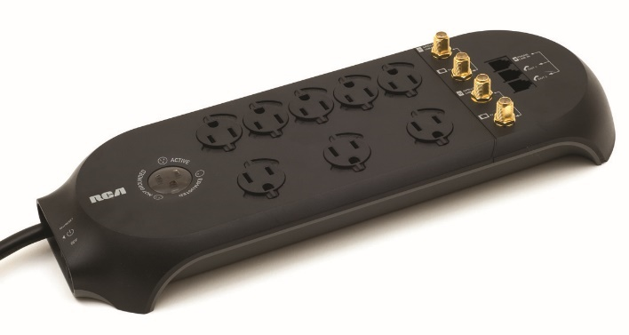

Surge Suppressors
Power conditioning
Feature that filters out EMI and RFI
Figure 8.8 Surge suppressor
Figure 8.9 Surge suppressor with telephone line protection
Notes:
To protect your power supply, a dedicated surge suppressor works between the power supply and the outlet to protect the system from power surges (see Figure 8.8).
If you use a modem, DSL, or cable modem, make sure to get a surge suppressor that includes support for these types of connections. Many manufacturers make surge suppressors with telephone line protection (see Figure 8.9).

Slide 20
Uninterruptible Power Supply
A UPS provides protection against a power sag or power outage.
A battery supplies continuous AC power.
Surge protection and power conditioning are provided.
All UPSs are measured in watts and volt-amps.
Watts are what your system uses.
Volt-amps are what UPS can deliver in a perfect world.
Try manufacturers’ Web sites for matching wattage with a specific system.
Look for a UPS with USB or Ethernet connector.
Notes:
Note that devices take the power from the UPS with less than 100 percent efficiency. A UPS tries to deliver perfect power, but some percentage is lost to inefficient devices. Thus, the guess at the effective wattage of the UPS made by the manufacturer.

Slide 21
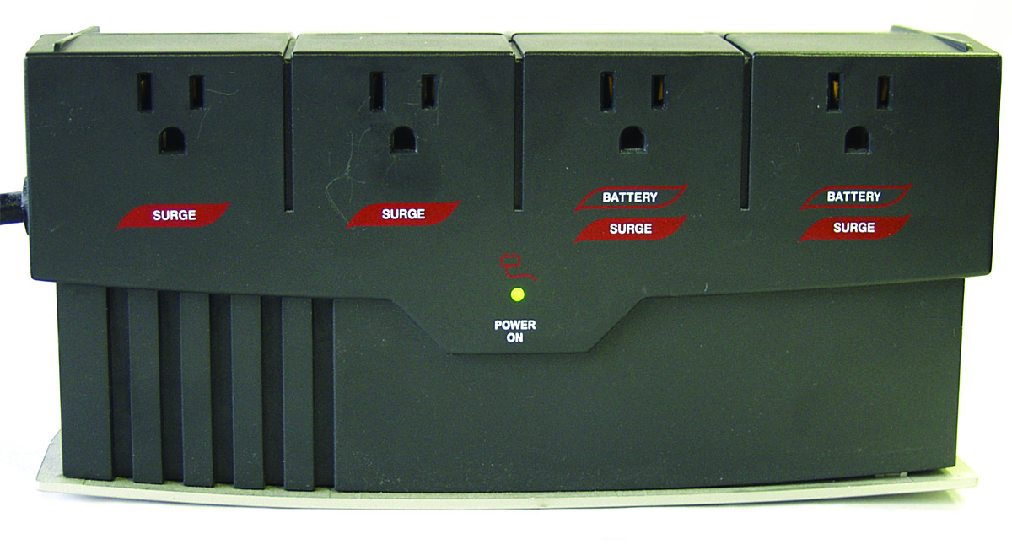
Uninterruptible Power Supply
Figure 8.10 Uninterruptible power supply
Notes:
An uninterruptible power supply (UPS) protects your computer (and, more importantly, your data) in the event of a power sag or power outage. Figure 8.10 shows a typical UPS.

Slide 22
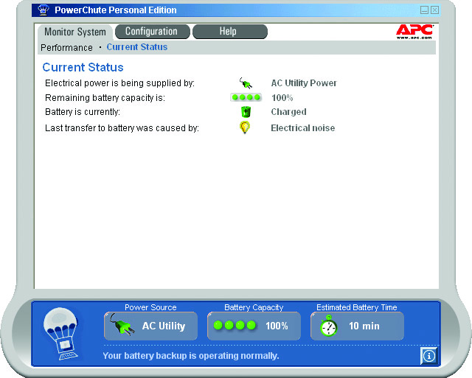
Uninterruptible Power Supply
Figure 8.11 APC PowerChute software
Notes:
UPSs come with monitoring and maintenance software (see Figure 11) that tells you the status of your system and the amount of battery power available, logs power events, and provides other handy options.

Slide 23
Uninterruptible Power Supply
Table 8.1 |  | Typical UPS Devices
Brand | Model |  | Outlets Protected | Backup Time | Price | Type
APC | BE350G |  | 3 @ 120 V | 3 min @ 200 W, 10 min @ 100 W | $43.99 | Standby
APC | Pro 1000 |  | 4 @ 120 B | 4 min @ 600 W, 64 min @ 100 W | $134.99 | Standby
CyberPower | CPS1500AVR |  | 6 @ 120 V | 18 min @ 950 W, 6 min @ 475 W | $279.99 | Line-interactive
Notes:
Table 8.1 gives you a quick look at the low end and the very high end of UPS products (as of early 2016).

Slide 24
Supplying DC
Power supply converts high-voltage AC into several DC voltages, notably, 5.0-, 12.0-, and 3.3 V.
PCs use a 12.0-V current to power motors on devices such as hard drives and optical drives.
PCs use a 5.0-V/3.3-V current to support onboard electronics.
Notes:
Discussion Topic
Power Supply
All PCs run on DC. All utilities companies provide AC, either as 110–120 VAC or 220–230 VAC, depending on the country you are in. Therefore, we need a method of taking that AC and safely converting, or “transforming,” it to the 12, 5, and 3.3 volts of DC. All power supplies, regardless of form factor, size, internal, or external, act as “step-down” transformers to provide that conversion from household AC to the DC that the PC can use.
Why do PCs use DC?
Switching aside, digital devices are fundamentally “DC” in nature. You couldn’t create them any other way; in fact, that is part of the definition of a digital device. Digital devices deal with logic levels; you need a steady (DC) voltage to represent a 1 and another steady voltage to represent a 0. Power is used each time a level changes. AC is constantly changing, and is defined by a peak voltage and a frequency, so a single voltage reading is meaningless. For example, a house outlet could be 140 V one time then –30 V, etc. another time (120 V outlet swings between –170 V and 170 V).
Source: Moridin on sharkyforums.com.
AC makes the most sense in power distribution, but DC makes the most sense in actual devices. This is especially true in digital circuitry for exactly the reasons Moridin mentions. “Around the turn of the century, Thomas Edison was a leading proponent of DC distribution (i.e., DC power lines) and a system of DC distribution was implemented in the East coast. Another inventor, Tesla IIRC, argued in favor of AC distribution as a method to improve the efficiency of power distribution and in the end AC distribution won out.” ------------------ Patrick Mahoney IPF (McKinley) Microprocessor Design Intel Corp. * Not speaking for Intel Corp. *

Slide 25
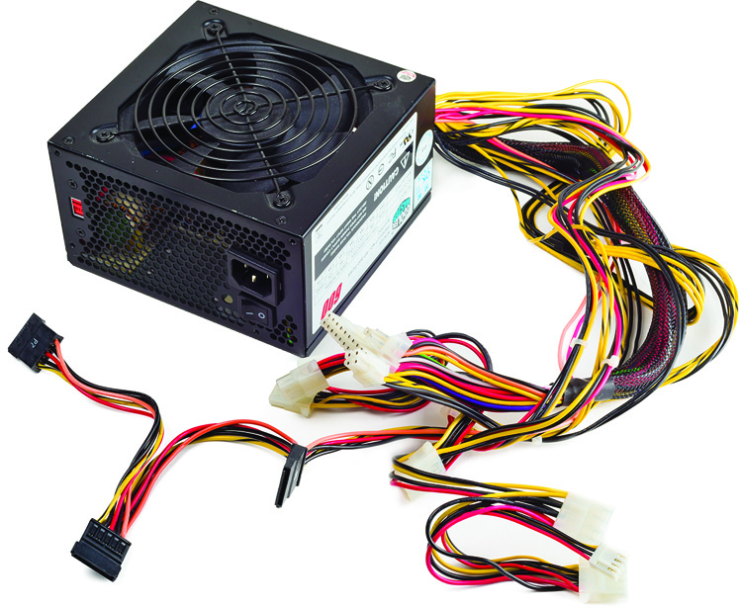
Supplying DC
Figure 8.12 Desktop PSU
Notes:
Power supplies come in a large number of shapes and sizes, but the most common size by far is the standard 150 mm × 140 mm × 86 mm desktop PSU shown in Figure 8.12.

Slide 26
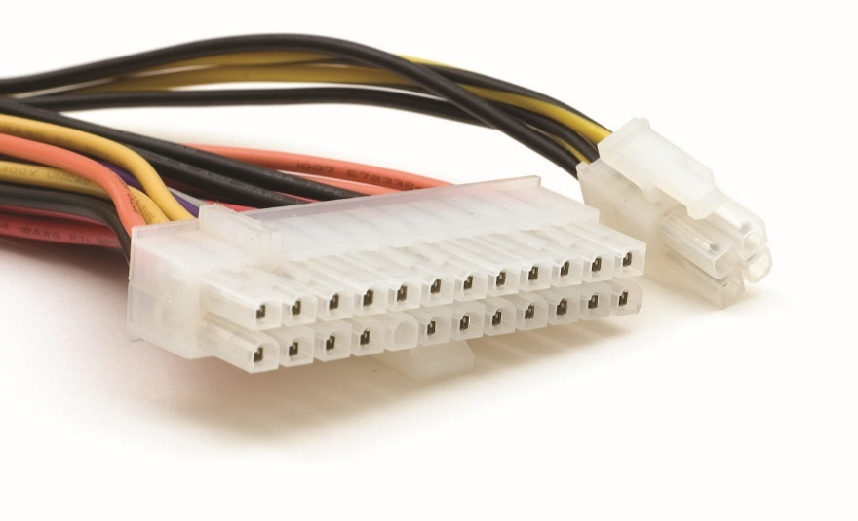
Power Connectors
Power to the motherboard
Modern motherboards use a 20- or 24-pin P1 power connector.
Some may require additional 4-, 6-, or 8-pin connectors to supply extra power.
Connectors for peripherals include:
Molex
Mini
SATA
Figure 8.13 Motherboard power connectors
Notes:
PCI Express video cards often need more power than they can draw from the expansion slot and thus require either a Molex connector or a dedicated, six-wire PCIe connector. The latter will offer three 12-volt connections. These connectors are not tested on the CompTIA A+ exams.

Slide 27
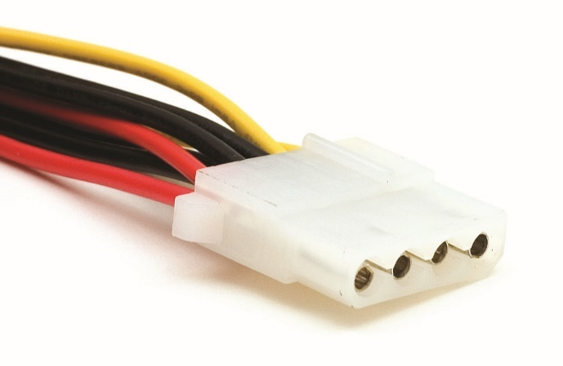
Power Connectors
Molex connector
The Molex connector supplies 5-V and 12-V current for fans and older drives.
Chamfers are notches on the connector that guide installation.
Molex connectors require a firm push to plug in properly.
Figure 8.14 Molex connector

Slide 28
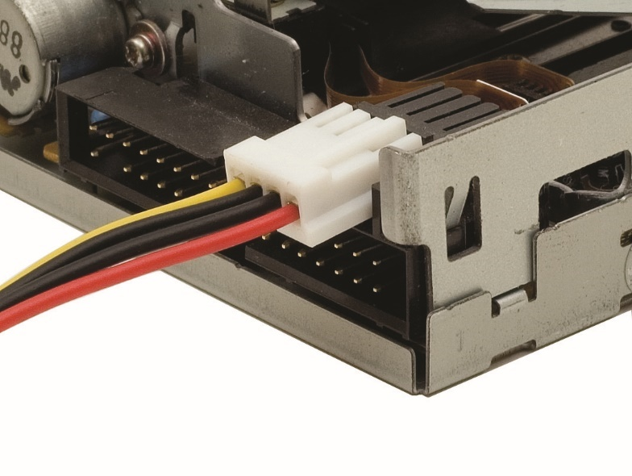
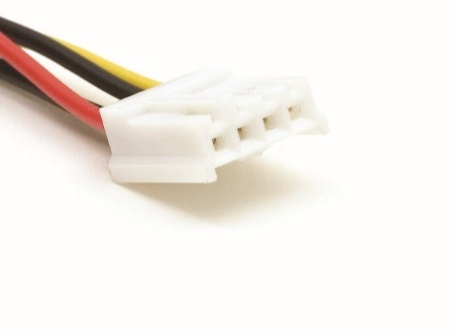
Power Connectors
Mini connector
Used only for extinct 3.5 inch floppy disk drives
Can insert incorrectly with very little effort
Figure 8.15 Mini connector
Figure 8.16 Correct orientation of a mini-connector

Slide 29
Power Connectors
SATA power connectors
Used for serial ATA drives
15-pin connection
Supports the SATA hot-swappable feature and 3.3-, 5.0-, and 12.0-V devices
L-shaped; almost impossible to insert incorrectly
Splitters and adapters
Can create two power connectors from one
Can convert Molex to a SATA connector
Notes:
Note: Modern power supplies include a lot of connectors. You’ll find cheaper ones with as few as 10 connectors. More powerful models could have 25 or more.

Slide 30
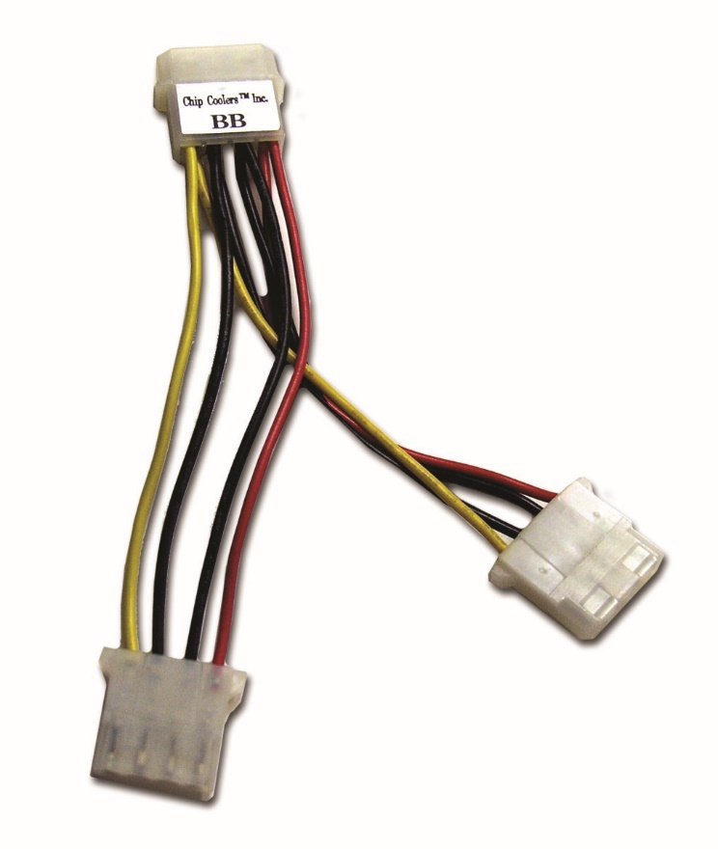
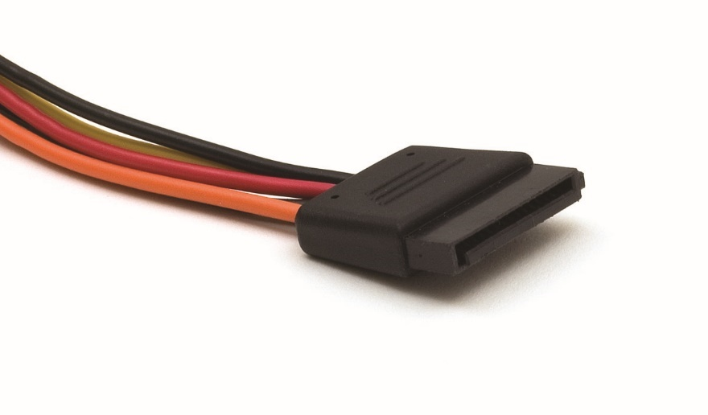
Power Connectors
Figure 8.17 SATA power connector
Figure 8.18 Molex splitter
Notes:
Serial ATA (SATA) drives need a special 15-pin SATA power connector (see Figure 8.17).
Splitters can create more connections (see Figure 8.18).

Slide 31
ATX
Original ATX power supplies featured:
The motherboard power connector
Soft power, which involves the BIOS or operating system in turning the PC on or off
ATX systems are always on when plugged in.
5 V supplied to motherboard when plugged in
The most important settings for ATX soft power reside in CMOS setup.
Power Management section

Slide 32
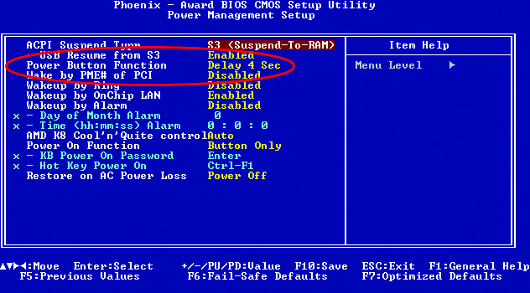
ATX
Figure 8.19 Soft power setting in CMOS

Slide 33
Power Supply Versions
ATX12V 1.3
First widespread update to ATX PS
Introduced a 4-pin motherboard power connector, called the P4 power connector
Also introduced the AUX connector
EPS12V
Used for server motherboards
Introduced rails

Slide 34
Power Supply Versions
Rails
A single transformer takes the AC current from a wall socket and converts it into DC current split into three primary DC voltage rails:
12.0 V, 5.0 V, and 3.3 V
Single-rail system has a single over-current protection (OCP) monitor.
Multi-rail system provides each pathway with its own OCP.
Notes:
In the past, 12-V rails only supplied about 18 amps, which wasn’t enough to power all that high-end equipment. Today’s power-supply manufacturers seem more interested in single, high-amperage, 12-V rails, ignoring the 16–18 amp rule. You can find power supplies now with 12-V rails pushing 50 amps or more.

Slide 35
Power Supply Versions
ATX12V 2.0
24-pin connector that is backward compatible with older 20-pin connector
Requires two 12-V rails for any power supply rated higher than 230Rails should not draw power from each other
A dedicated 6-pin or 8-pin PCIe power connector on higher-end cards

Slide 36
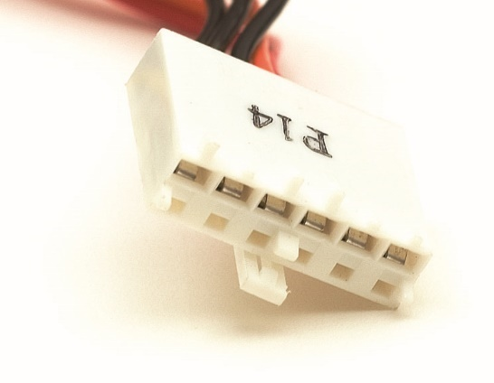
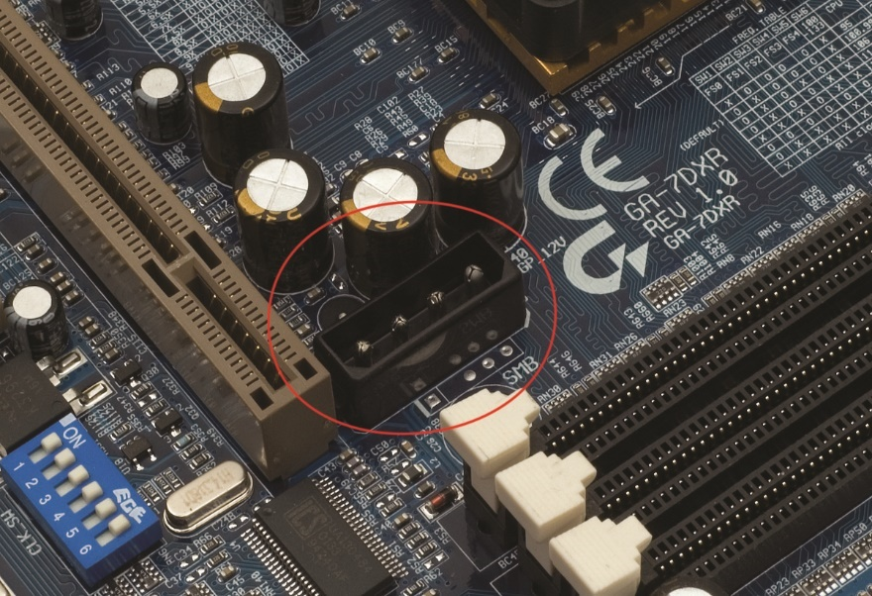
Power Supply Versions
Figure 8.20 Auxiliary power connector
Figure 8.21 Molex power on motherboard
Notes:
The ATX12V 1.3 standard also introduced a 6-pin auxiliary connector—commonly called an AUX connector—to supply increased 3.3- and 5.0-V current to the motherboard (see Figure 8.20). This connector was based on the motherboard power connector from the precursor of ATX, called AT.
A few motherboard makers skipped adding either connector and used a standard Molex connector so people with older power supplies wouldn’t have to upgrade just because they bought a new motherboard (see Figure 8.21).

Slide 37
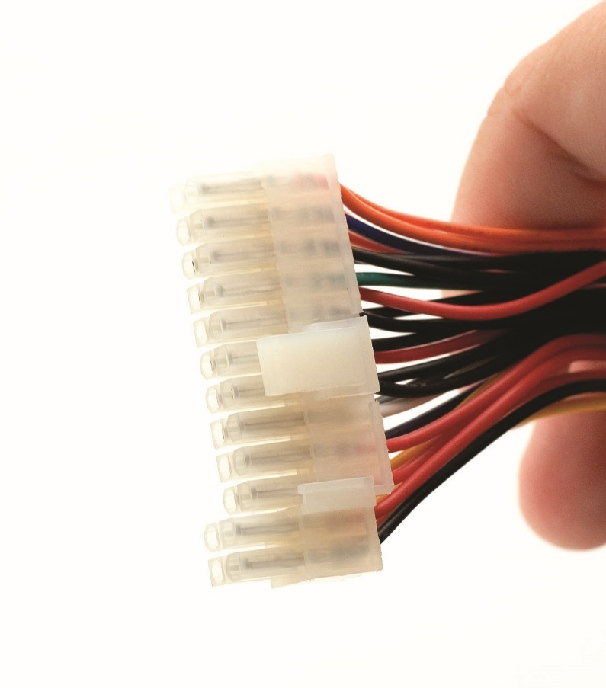
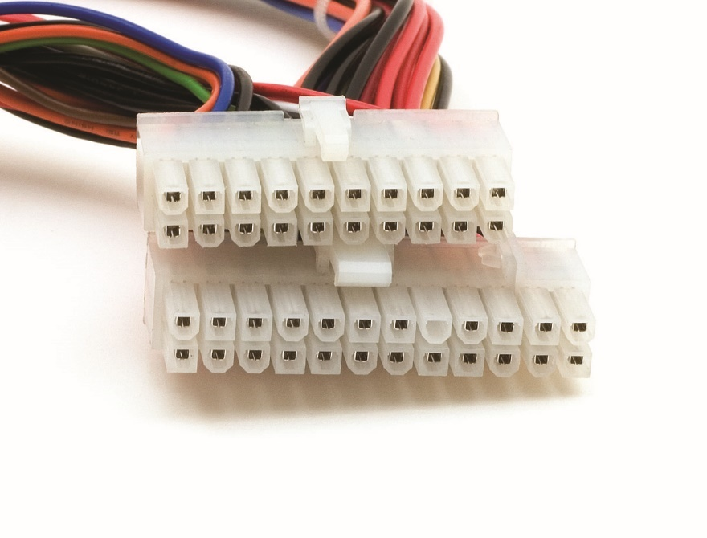
Power Supply Versions
Figure 8.22 20- and 24-pin connectors
Figure 8.23 Convertible motherboard power connector
Notes:
Figure 8.22 shows 20-pin and 24-pin connectors; Figure 8.23 shows a convertible connector. Although they look similar, those extra four pins won’t replace the P4 connector. They are incompatible!

Slide 38
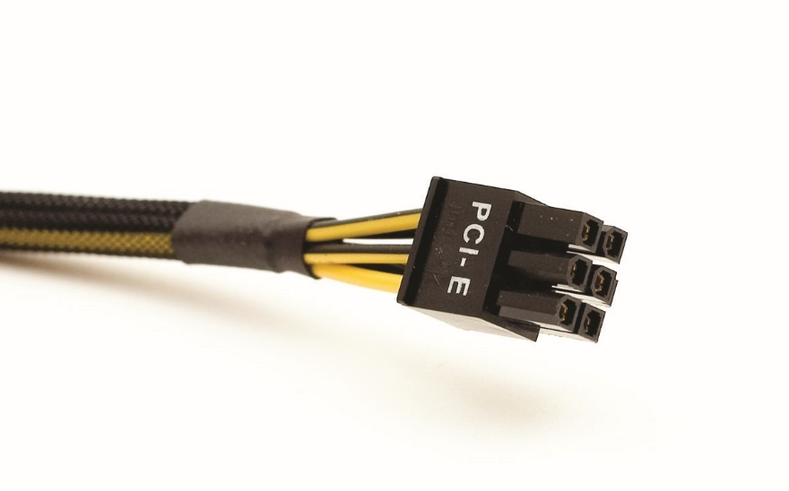
PCI Express
Figure 8.24 PCI Express 6-pin power connector
Notes:
Another notable connector is the auxiliary PCI Express (PCIe) power connector. Figure 8.24 shows the 6-pin PCIe power connector. Some motherboards add a Molex socket for PCIe, and some cards come with a Molex socket as well. Higher-end cards have a dedicated 6-pin or 8-pin PCIe power connector.

Slide 39
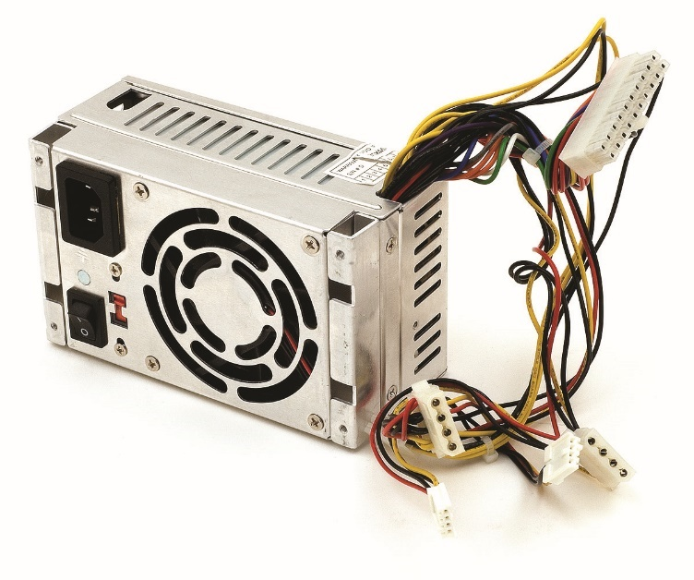
Form Factors
Niche market power supply form factors
Mini ATX and Micro ATX, TFX12V, SFX12V, CFX12V, LFX12V
Active power factor correction (active PFC)
Common in quality power supplies
Eliminates harmonics
Figure 8.25 SFX power supply

Slide 40
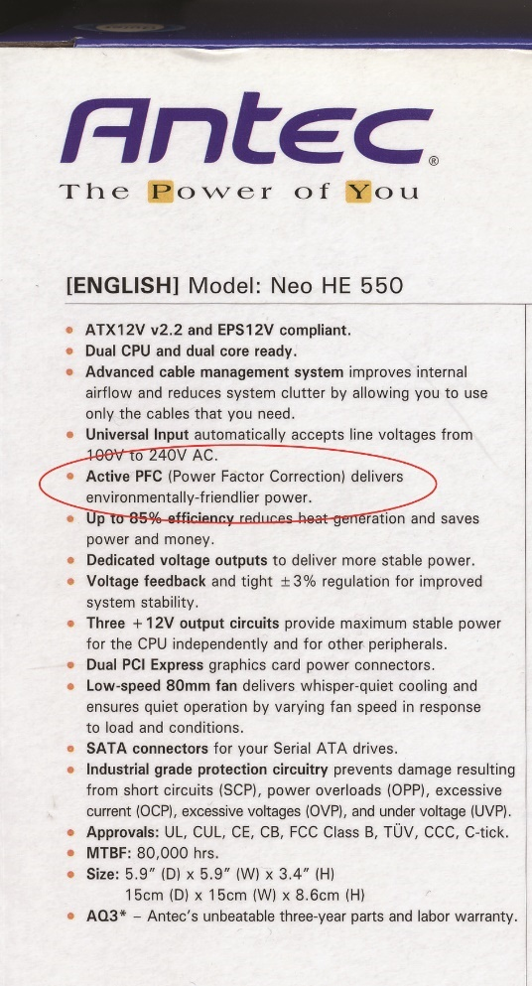
Form Factors
Figure 8.26 Power supply advertising active PFC
Notes:
Good PC power supplies come with active power factor correction (active PFC), extra circuitry that smoothes out the way the power supply takes power from the power company and eliminates harmonics (see Figure 8.26).

Slide 41
Wattage Requirements
Every device requires some wattage.
Starting requirements are usually higher than running requirements.
Power supplies don’t run at 100 percent efficiency.
ATX 12 V requires power supplies to be at least 70 percent efficient.
General recommendation
Use at least a 500-W power supply.
Enough extra for starting and future growth

Slide 42
Installing Power Supplies
Removing
Unplug ATX system prior to any work!
Remove four standard screws.
Remove PSU.
To install
Place PSU in case.
Replace screws.

Slide 43
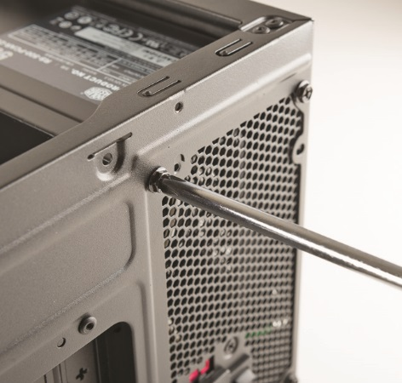
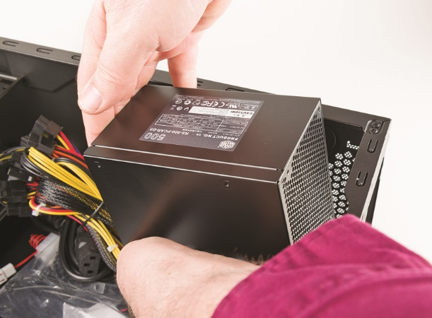
Installing Power Supplies
Figure 8.27 Mounting screws for power supply
Figure 8.28 Removing power supply from system unit
Notes:
The typical power supply connects to the PC with four standard computer screws, mounted in the back of the case (see Figure 8.27). Unscrew the four screws and the power supply lifts out easily (see Figure 8.28). Insert a new power supply that fits the case and attach it by using the same four screws.

Slide 44
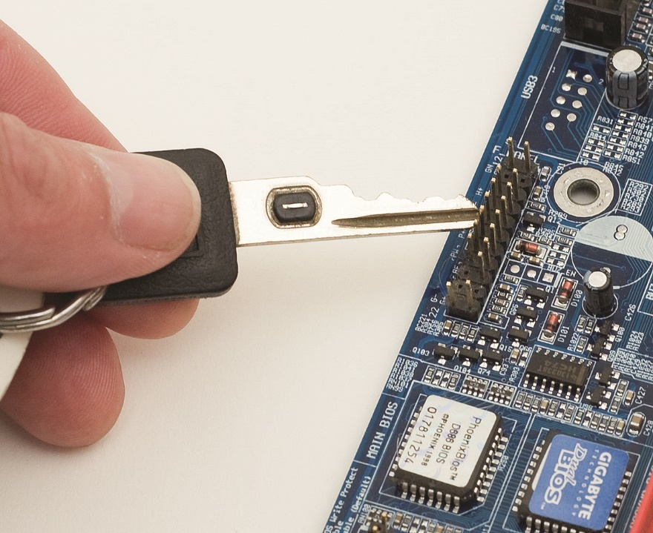
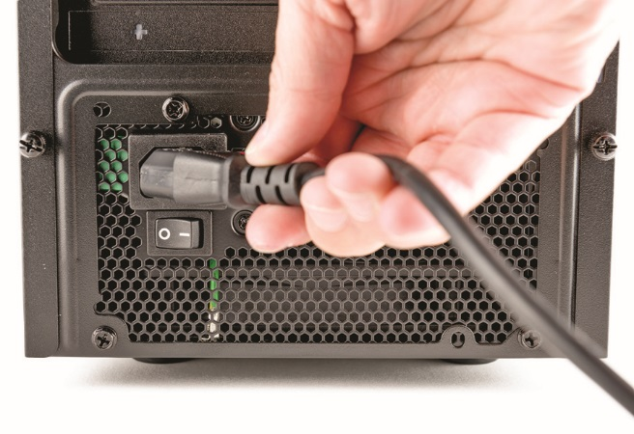
Installing Power Supplies
Figure 8.29 On/off switch for an ATX system
Figure 8.30 Shorting the soft on/off jumpers
Notes:
Many ATX power supplies provide a real on/off switch on the back of the PSU (see Figure 8.29).
One trick when in that situation is to use a set of car keys or a screwdriver to contact the two wires to start and stop the system (see Figure 8.30).

Slide 45
Cooling
The power supply fan provides basic cooling for the PC.
The fan keeps the voltage regulators cool.
The power supply fan provides a constant flow of outside air through the interior of the computer case.
If power supply fan stops, replace power supply.
Some power supplies have sensors to help regulate air flow.

Slide 46
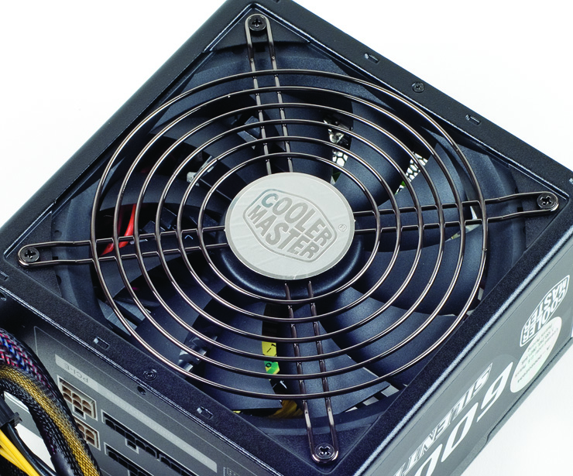
Cooling
Figure 8.31 Power supply fan

Slide 47
Cooling
Case fan provides extra cooling for key components.
Most modern computers have case fans.
Often, they plug into Molex connector.
Connector adapters can be used.
A closed case enables the fans to create airflow.
Warm air rises.
Intake fan located near bottom front bezel
Cover empty expansion bays with slot covers.

Slide 48
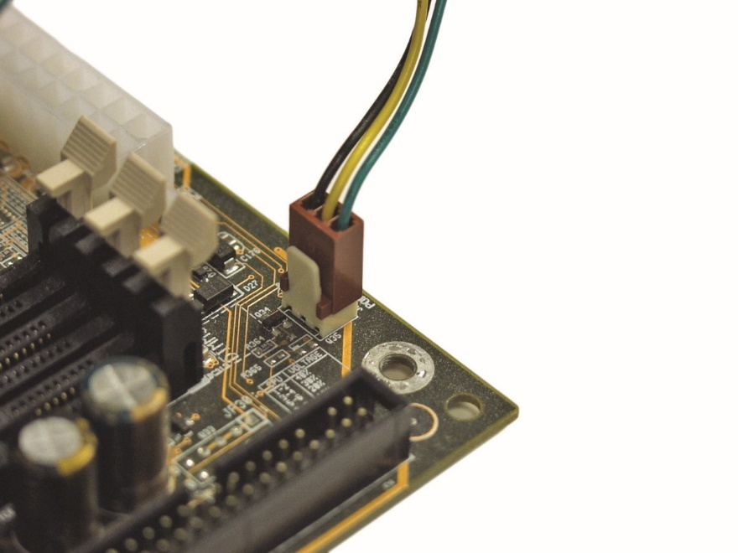
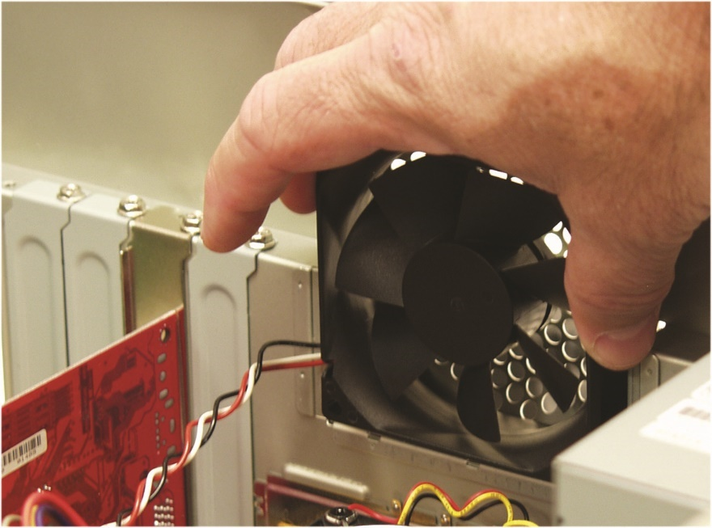
Cooling
Figure 8.32 3-wire fan sensor connector
Figure 8.33 Case fan
Notes:
Some power supplies come with a built-in sensor to help regulate the airflow. If the system gets too hot, the power supply fan spins faster. The 3-pin, 3-wire fan sensor connector plugs into the motherboard directly (see Figure 8.32).
Case fans are large, square fans that snap into special brackets on the case or screw directly to the case, providing extra cooling for key components (see Figure 8.33).

Slide 49
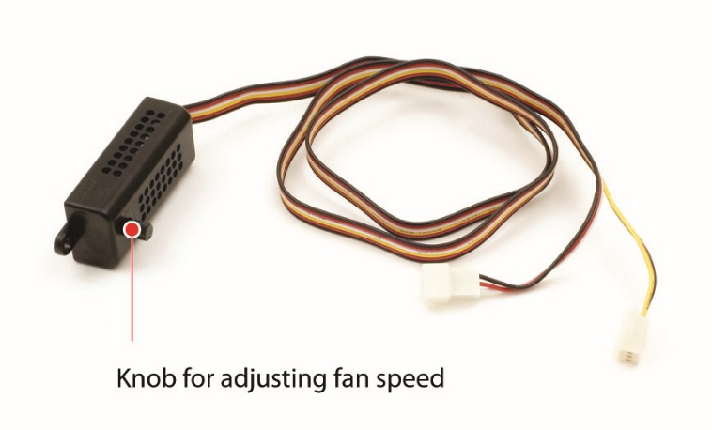
Reducing Fan Noise
Some fans can be adjusted.
Manually adjustable with knob
Software adjustable
Larger fans that spin more slowly are quieter.
Higher-end fans are quieter.
Use better bearings
Figure 8.35 Manual fan adjustment device

Slide 50
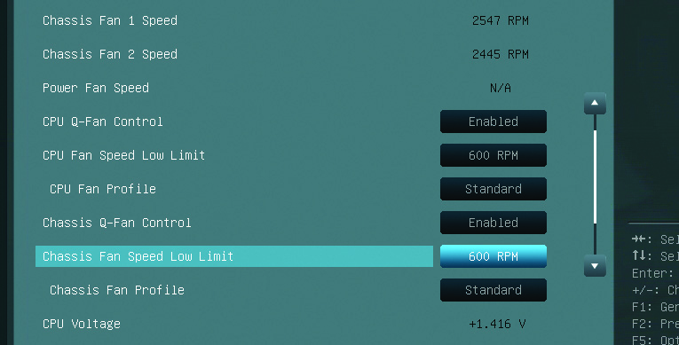
CMOS Fan Options
Can monitor PC’s health by showing temperatures
Doesn't control fans
Can set fan thresholds for alarms
Figure 8.36 CMOS fan options
Notes:
Instructor: have the students power up the student PC and go into System Setup to see the power options.

Slide 51
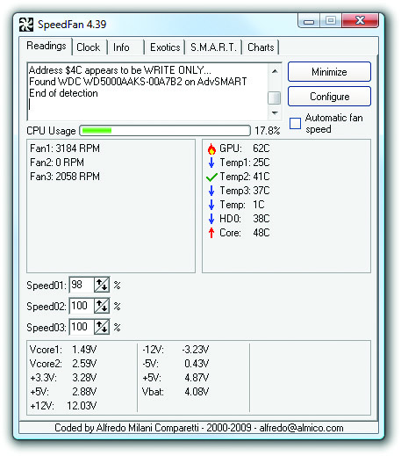
SpeedFan Utility
Allows monitoring of fan speeds
Can set fan speeds
Supports hundreds of chipsets
Visit the Web site:
www.almico.com/speedfan.php
Figure 8.37 SpeedFan

Slide 52
Troubleshooting
Power supplies fail in two ways:
Sudden death
The fan doesn't turn and no voltage is present.
Computer simply stops working.
Slowly over time
Intermittent errors occur.
Output voltages may safely vary ± 10 percent.
Replacement of the power supply is cheaper than repair.

Slide 53
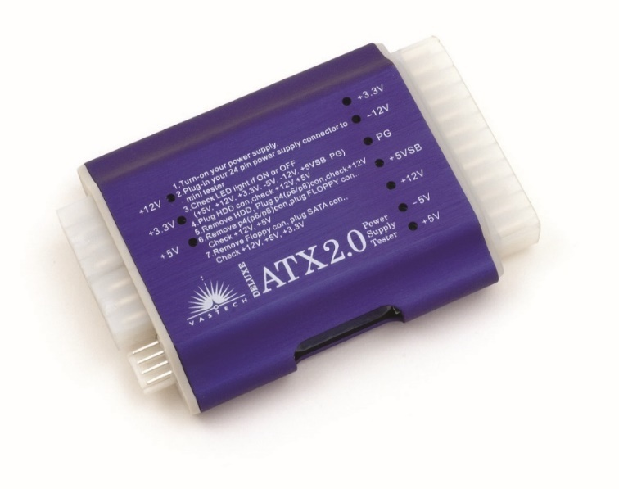
Power Supply Test
Power supplies need a load.
Plug into the motherboard.
Plug into a tester.
Check power switches.
Try shorting the soft power jumpers.
Figure 8.39 ATX power supply tester
Notes:
Many CMOS utilities and software programs monitor voltage, saving you the hassle of using a multimeter. Of course, you have to have enough functionality to get into the CMOS utilities!

Slide 54
Failing Power Supply
Intermittent problems
Sometimes problem occurs and sometimes it does not.
First guess should be that the power supply is bad.
A dying power supply can cause:
Random lockups and reboots
Sporadic boot-up difficulties
When you encounter intermittent symptoms, consider replacing the power supply.

Slide 55
Fuses and Fire
Fuses blow for a reason.
Power supply is malfunctioning.
As a designed safety precaution, fuses blow (break) to stop circuit.
Failure to respect the power of electricity can result in an electrical fire.

Slide 56
Fire Extinguishers
Class A
Ordinary combustibles such as paper and wood
Class B
Flammable liquids such as gasoline
Class C
Live electrical equipment
Class D
Combustible metals: titanium or magnesium
Class K
Cooking oils, trans-fats, or fats

Slide 57
Beyond A+
It glows!
Today’s power supplies may include features such as fancy colors, power supplies that light up, or extra fans.
Modular power supplies
These allow fewer cables by adding only the lines needed for your system.
Temperature efficiency
Power supplies provide less power in warmer temperatures—pay attention to operating temps.

Slide 58
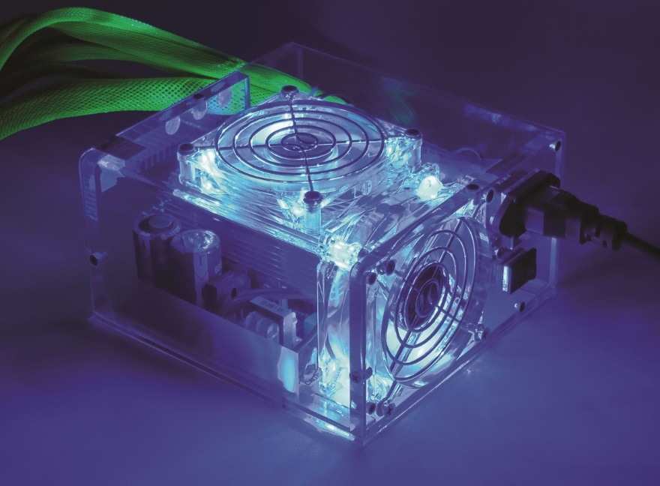
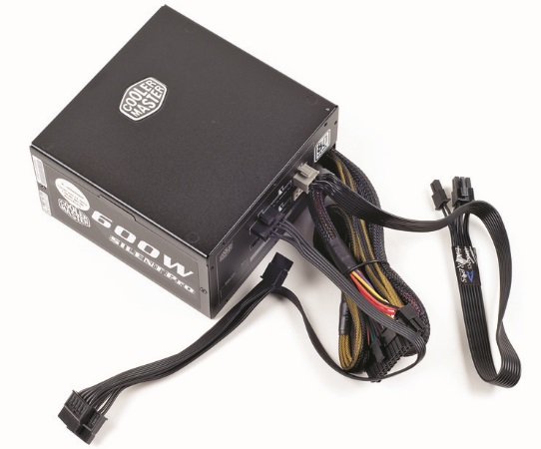
Beyond A+
Figure 8.40 See-through power supply that glows blue
Figure 8.41 Modular-cable power supply
Notes:
There are power supplies that light up, sport a fancy color, or have multiple fans. Figure 8.40 shows a see-through PSU.
Unused power cables dangling around inside PCs creates a not-so-pretty picture. To help stylish people, manufacturers created power supplies with modular cables (see Figure 8.41).

Slide 59
Questions?

Slide 60
Summary
Explain the basics of electricity
Describe the details about powering the PC
Install and maintain power supplies
Understand power supply troubleshooting and fire safety

Slide 61


